Slide 1
Integration of Multiple Static Analysis Tools in a Single Interface
G. S. Varma
Supervisors:
Prof. Dr. Eric Bodden
Dr.-Ing. Ben Hermann

Slide 2
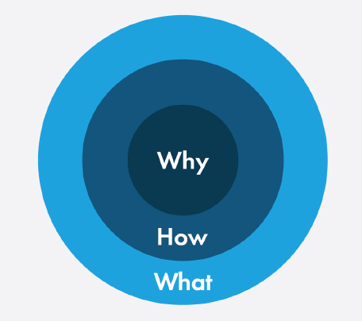

Slide 3
Problem Statement
How to integrate the results of multiple static analysis tools
in a unified user interface?
3 Research Questions

Slide 4
Research Questions
RQ 1: How to display results of the same codebase from different analysis tools?
RQ 2: What feedback works to know that bug fixing is on-going?
RQ 3: How to carry traceability of bug fixing?

Slide 5
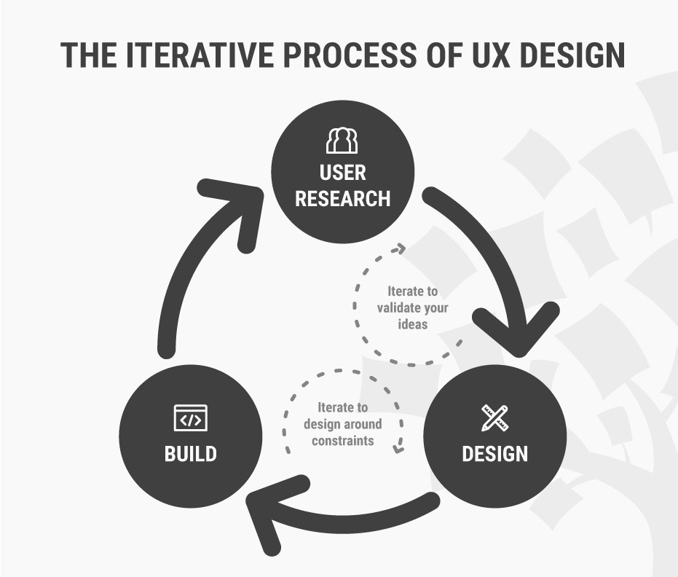
Research Methodology
How to Change Your Career from Graphic Design to UX Design. url: https://www.interaction-design.org/literature/article/ how-to-change-your-career-fromgraphic-design-to-ux-design.

Slide 6
Our Approaches
Software Engineering disciplines:
Complex datasets
Compiler reporting
Continuous integration
Refactoring tools
Issue tracker
Stack Overflow
Gamification
Usability Engineering

Slide 7

Evaluation
Experimental Design
Recruit Test Users
Order of evaluation altered
Perform Tasks ( Metric 1 – Task Success )
Likert Scale ( Metric 2 – Perceived Usability )
Usability inspection methods: Cognitive Walkthrough
Rensis Likert. “A technique for the measurement of attitudes.” In: Archives of psychology (1932).

Slide 8
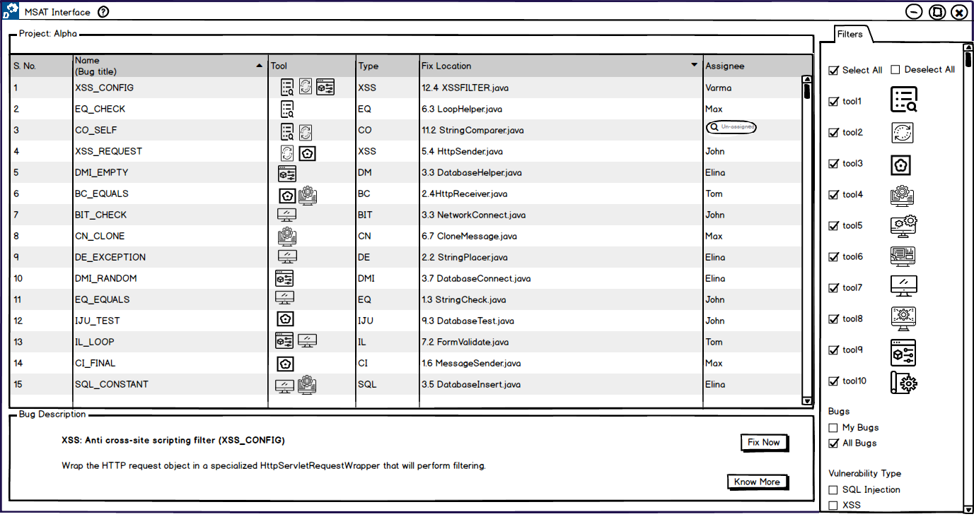
Analysis View

Slide 9
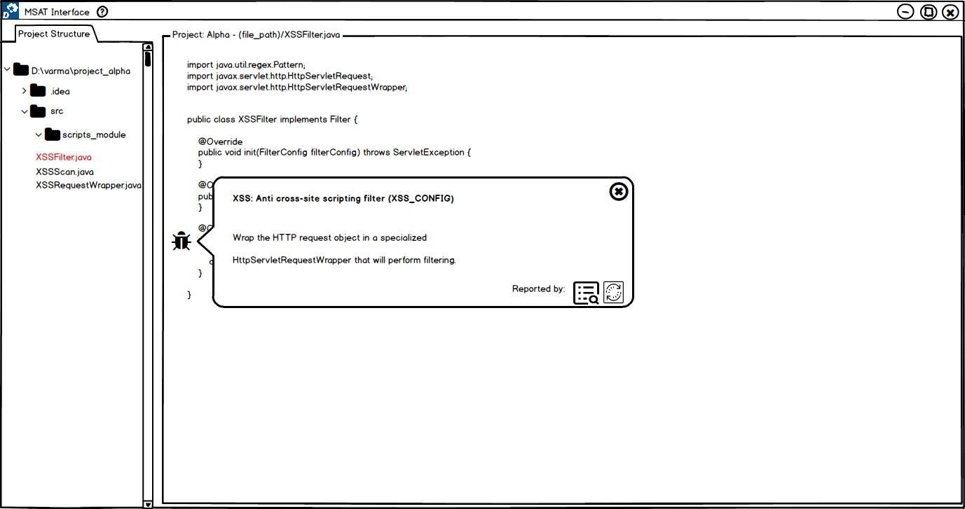
Code View

Slide 10
UX Design Cycle 1

Slide 11

UX 1
Users: 5
Sub research questions: 9
Each session: ~ 90 minutes

Slide 12
UX 1
 | Analysis View
RQ 1 ( display ) | Tags Single List Separate List Statistics Screen
RQ 2 ( feedback ) | Animated Icons Progress Bar Popup
RQ 3 ( trace ) | Numbers

Slide 13
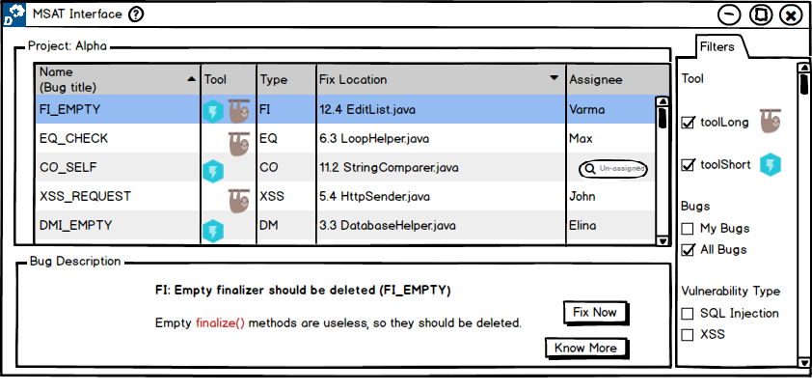
[ RQ 1.1 ] Does a separate list or single list help the user to identify the common bug?
Single List

Slide 14
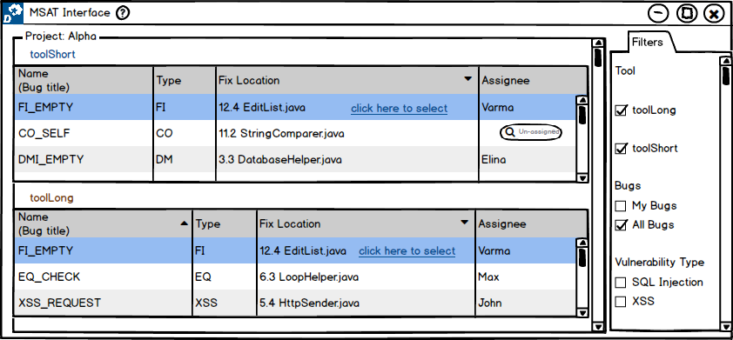
[ RQ 1.1 ] Does a separate list or single list help the user to identify the common bug?
Seperate List

Slide 15

[ RQ 1.1 ] Does a separate list or single list help the user to identify the common bug?
Results:
 | Single List | Separate List
Task Success | 100 % | 100 %
Usability | 8 | 7.6
Votes | 2 | 3
Separate List – “more effective when using more tools”

Slide 16
UX 1 - Findings
 | Analysis View
RQ 1 ( display ) | Tags Single List Separate List Statistics Screen
RQ 2 ( feedback ) | Animated Icons Progress Bar Popup
RQ 3 ( trace ) | Numbers

Slide 17
UX 1 – Lessons
Analysis View
Improvisations for next UX cycle:
Increase code base
Volume of bugs ( + scroll )
Integrate more tools
Code view perspective
+ new sub RQ’s

Slide 18
UX Design Cycle 2

Slide 19

UX 2
Users: 7
Sub research questions: 9
Each session: ~ 105 minutes

Slide 20
UX 2
 | Analysis View | Code View
RQ 1 ( display ) | Tags Single List Separate List | Multiple Icons Single Icon
RQ 2 ( feedback ) | Animated Icons Progress Bar Popup | Toasts ( alerts ) Spinner ( status )
RQ 3 ( trace ) | Numbers Adjectives | Before/After

Slide 21
[ RQ 1.1 ] Does a separate list or single list help the user to identify the common bug?
Single List

Slide 22
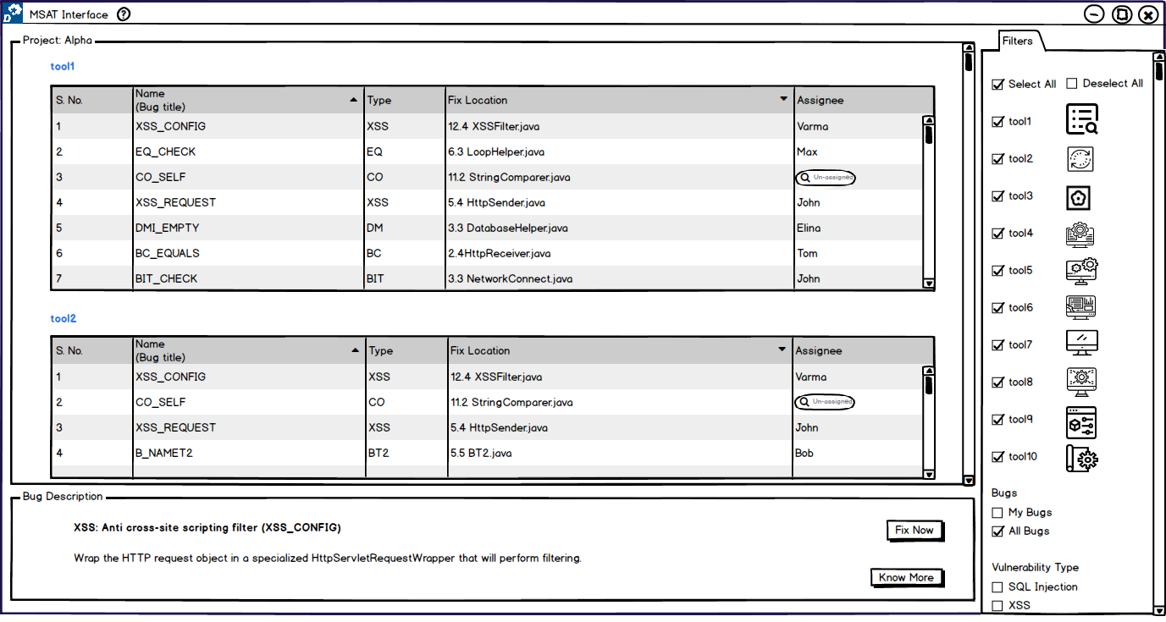
[ RQ 1.1 ] Does a separate list or single list help the user to identify the common bug?
Separate List

Slide 23
[ RQ 1.1 ] Does a separate list or single list help the user to identify the common bug?
Results:
 | Single List | Separate List
Task Success | 71.43 % | 42.85 %
Usability | 8.14 | 5.43
Votes | 5 | 0
Single List – “effortless to perceive, more user friendly”

Slide 24
UX 2 - Findings
 | Analysis View | Code View
RQ 1 ( display ) | Tags Single List Separate List | Multiple Icons Single Icon
RQ 2 ( feedback ) | Animated Icons Progress Bar Popup | Toasts ( alerts ) Spinner ( status )
RQ 3 ( trace ) | Numbers Adjectives | Before/After

Slide 25
UX 2 – Lessons
Analysis / Results View
Code View
UX 1 Scalability
Improvisations for next UX cycle:
UX 2 Scalability
+ new sub RQ’s

Slide 26
UX Design Cycle 3

Slide 27
UX 3
Users: 5
Sub research questions: 13
Each session: ~ 120 minutes

Slide 28
UX 3
 | Analysis View | Code View
RQ 1 ( display ) |  | Next List view Bug icons Table view Vertical view Horizontal view Similar boxes Similar list
RQ 2 ( feedback ) | Animated Icons Progress Bar Popup | Toasts ( alerts ) Spinner ( status )
RQ 3 ( trace ) |  | Before/After Table view

Slide 29



[RQ 2.1] How usable are each feedback functionality compared to the scenario of using uniﬁed UI to native UIs?
Evaluation Setup: 3 native UI tools for a JavaScript project.
CLI – ESLint
IDE – SonarLint
WEB - SonarQube
ESLint – The pluggable linting utility for JavaScript and JSX. url: https://eslint.org/
Sonarlint - Fix issues before they exist. url: https://www.sonarlint.org/
Sonarqube - Code Quality and Security . url: https://www.sonarqube.org/

Slide 30
[RQ 2.1] How usable are each feedback functionality compared to the scenario of using uniﬁed UI to native UIs?
Almost all users agreed the ideas being novel and hardly present with native UIs.
Result | MSAT-UI | Native UI
Animated Icons | 8.4 | 0
Progress Bar | 7.6 | 0.8
Pending Status Popup | 7.8 | 0
Alerts | 9.2 | 0
Status | 8.8 | 4

Slide 31
UX 3 - Findings
 | Analysis View | Code View
RQ 1 ( display ) |  | Next List view Bug icons Table view Vertical view Horizontal view Similar boxes Similar list
RQ 2 ( feedback ) | Animated Icons Progress Bar Popup | Toasts ( alerts ) Spinner ( status )
RQ 3 ( trace ) |  | Before/After Table view

Slide 32


Limitations
Number of participants: >
UX 1 – 5
UX 2 – 7
UX 3 – 5
Priming, Recency bias: Latin Square partition
Closed Study, Design Tool
Why You Only Need to Test with 5 Users. url: https://www.nngroup.com/articles/why-you-only-need-to-test-with-5-users
Balsamiq – Rapid, effective and fun wireframing software. url: https://balsamiq.com/

Slide 33
Findings
 | Analysis View | Code View
RQ 1 ( display ) | Single list | List view Single icon Table view Similar list
RQ 2 ( feedback ) | Animated Icons Progress Bar Popup | Toasts ( alerts )
RQ 3 ( trace ) | Adjectives | Table view

Slide 34
Future Work
Q. Would having tabs help scale the tools visibility with bugs results?
Q. Do graphs help in understanding the bugs reported?
RQ 4: How is teamwork facilitated in bug fixing in context of multiple tools?
… many more!

Slide 35
Summary
Importance of Static Analysis tools
Usage of Multiple Static Analysis tools
Need for a single user interface for multiple tools
This thesis work followed UX Design Cycle to achieve usable prototypes focussing on primary research questions such as,
How to display results of the same codebase from different analysis tools?
What feedback works to know that bug fixing is on-going?
How to carry traceability of bug fixing?

Slide 36
Backup Slides

Slide 37
Static Code Analysis
Johnson et al.
Christakis et al.
Habib et al.
Usability Issues
Brittany Johnson, Yoonki Song, Emerson Murphy-Hill, and Robert Bowdidge. 2013. Why don't software developers use static analysis tools to find bugs?. In Proceedings of the 2013 International Conference on Software Engineering (ICSE '13). IEEE Press, Piscataway, NJ, USA, 672-681.
Maria Christakis and Christian Bird. 2016. What developers want and need from program analysis: an empirical study. In Proceedings of the 31st IEEE/ACM International Conference on Automated Software Engineering (ASE 2016). ACM, New York, NY, USA, 332-343. DOI: https://doi.org/10.1145/2970276.2970347
Habib, A., & Pradel, M. (2018, September). How many of all bugs do we find? a study of static bug detectors. In ASE (pp. 317-328).

Slide 38
Multiple Tools
Developers use multiple static analysis tools each having own coverage.
Research trends:
Prioritise the bug warning alerts
( Flynn et al. )
Merges 3 tools for Java to show warnings
( Meng et al. )
Lori Flynn, William Snavely, David Svoboda, Nathan VanHoudnos, Richard Qin, Jennifer Burns, David Zubrow, Robert Stoddard, and Guillermo Marce-Santurio. 2018. Prioritizing alerts from multiple static analysis tools, using classification models. In Proceedings of the 1st International Workshop on Software Qualities and Their Dependencies (SQUADE '18). ACM, New York, NY, USA, 13-20. DOI: https://doi.org/10.1145/3194095.3194100
N. Meng, Q. Wang, Q. Wu and H. Mei, "An Approach to Merge Results of Multiple Static Analysis Tools (Short Paper)," 2008 The Eighth International Conference on Quality Software, Oxford, 2008, pp. 169-174.doi: 10.1109/QSIC.2008.30

Slide 39
Multiple Tools
Tricorder
Shipshape
Tricium
Parfait ( Cifuentes et al. )
( Sadowski et al. )
But USABILITY is not addressed…
Caitlin Sadowski, Jeffrey van Gogh, Ciera Jaspan, Emma Söderberg, and Collin Winter. 2015. Tricorder: building a program analysis ecosystem. In Proceedings of the 37th International Conference on Software Engineering - Volume 1 (ICSE '15), Vol. 1. IEEE Press, Piscataway, NJ, USA, 598-608.
Cristina Cifuentes and Bernhard Scholz. 2008. Parfait: designing a scalable bug checker. In Proceedings of the 2008 workshop on Static analysis (SAW '08). ACM, New York, NY, USA, 4-11. DOI=http://dx.doi.org/10.1145/1394504.1394505

Slide 40
UX 1

Slide 41
[ RQ 1 ] Does a separate list or single list help the user to identify the common bug?
Separate list outwins the single list with a slight majority of 3 out 5.

Slide 42
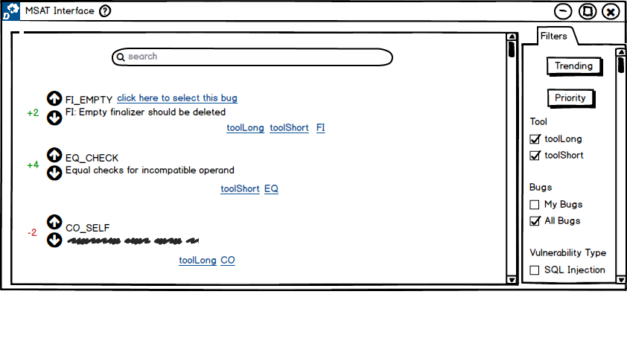
[ RQ 1 ] Will having tags help in scalability of bugs?
Yes! However, the interface is confusing. Users preferred single list in table format
solution idea as it suffices this scalability concern.

Slide 43
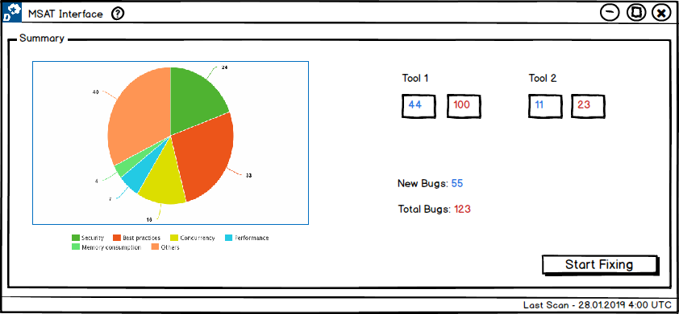
[RQ 1] Does the given statistics screen help the user in understating the analysis results overview?
Yes! It is conducive, especially when codebase is vast, and we use more analysis tools.

Slide 44
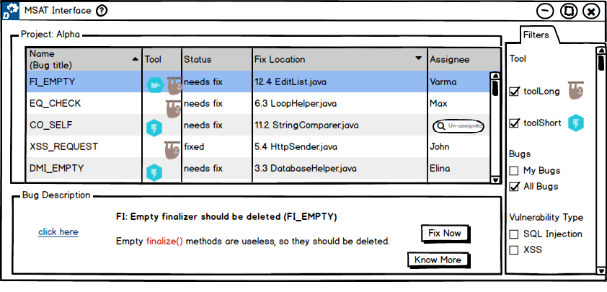
[RQ 2] Will the animation (rotation) of icons for tools suﬃce the feedback required by the user?
No! Users interested to see how far the analysis done and also to have more detailed
information on it.

Slide 45
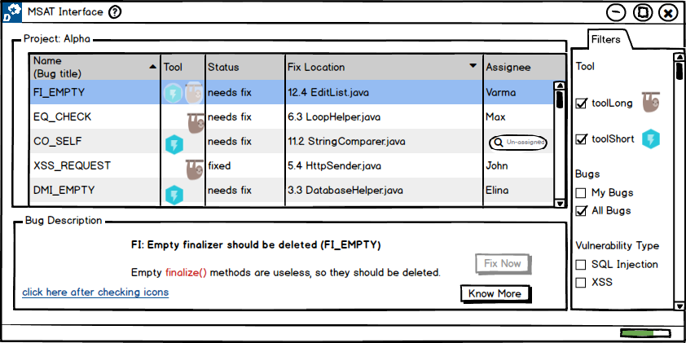
[RQ 2] Will stating the progress of analysis for each tool be better than animation provided as feedback to the user?
Yes! in terms of knowing the progress in completion of analysis.

Slide 46
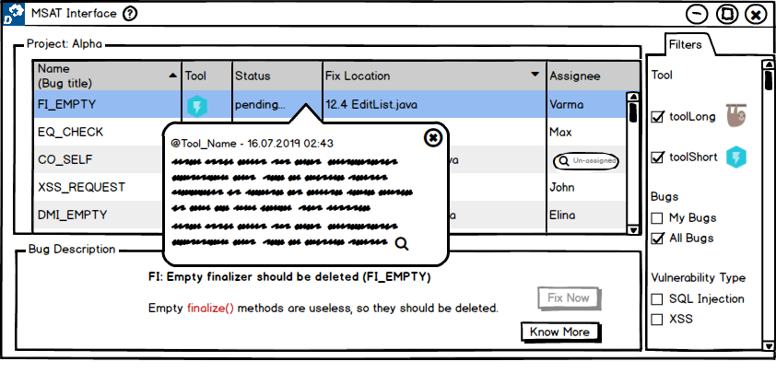
[RQ 2] Does having more textual information with a popup feedback is required by the user?
Yes! More information as possible is more beneficial from a user perspective being a
developer or tester.

Slide 47
[RQ 2] Do users require multiple feedbacks, i.e., any combination of animated icons, progress bar or pending status popup?
All the 3 feedback features
Animated Icons – What bugs are being analysed?
Progress Bar – How far the bugs got analysed?
Pending Status – more information on analysis
Yes! Especially progress bar with pending status popup.

Slide 48
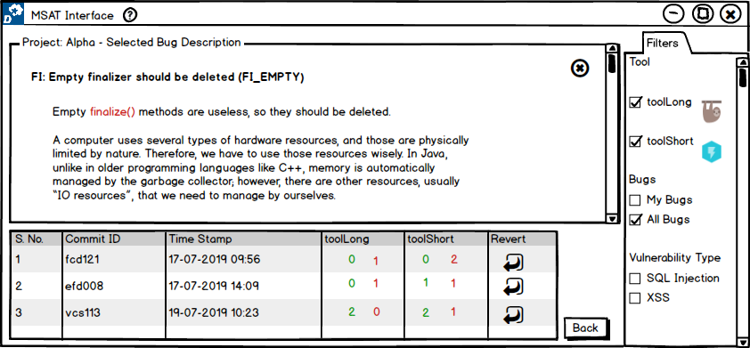
[RQ 3] Whether the given UI, i.e., previous commits in the process of ﬁxing a bug-ﬁnding with numbers determining the adding or removing of other bugs be able to address the scenario from the user perspective?
Yes! The proposed design is helpful for the given scenario.

Slide 49
[Post] Does onboard phase is required to understand the UI better?
No! enough text on screen would suffice.

Slide 50
UX 2

Slide 51
[RQ 1] From analysis view perspective, does a separate list or single list help the user to identify the common bug?
Users preferred single list as it is more user-friendly and effortless to perceive.

Slide 52
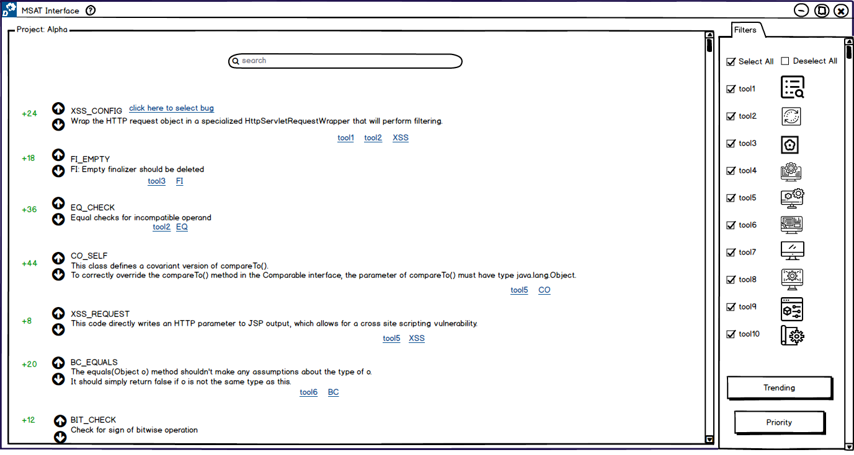
[RQ 1] From analysis view perspective, will tags help in scalability of bug results in comparison to separate list or single list?
No! Although the proposed design is novel and more open, couple of users explicitly
stated it to be confusing. Most users agreed with single list solution idea for this
scenario.

Slide 53
[RQ 1] From code view perspective, will single icon suﬃce the showing of diﬀerent tools icons?
Yes! Single icon solution idea outwins multiple icons solution idea with a majority
of 5 out of 7 users.

Slide 54
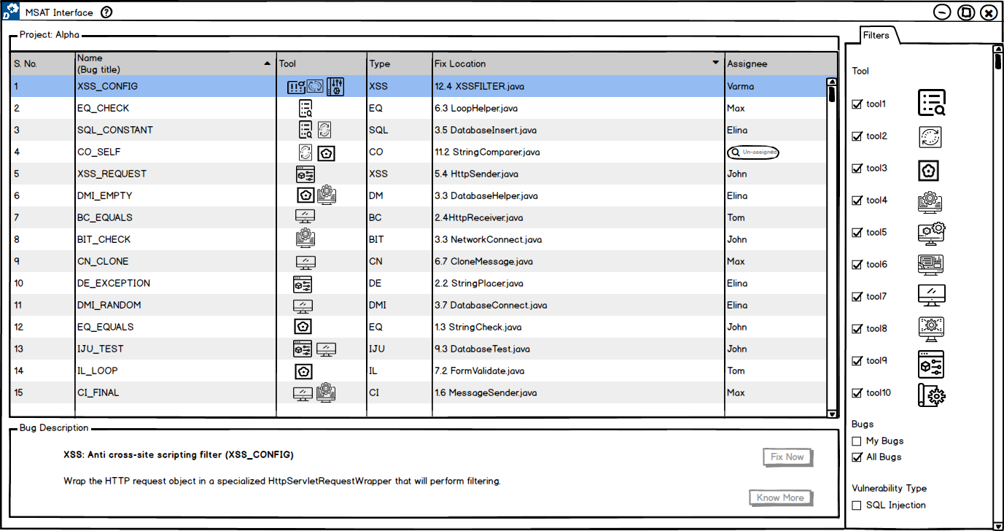
[RQ 2] When submitting the bug for analysis, what feedback does user feel convenient among animation, progress bar or popup?
Each has its prominence. However, users felt that pending status is more useful
among them.

Slide 55
[RQ 2] Does a single type of feedback suﬃce or requires combination?
All 3 solution ideas as each could be depict different understandings.
Users felt the requirement of the combination of all feedbacks as each serve in its
scope.

Slide 56
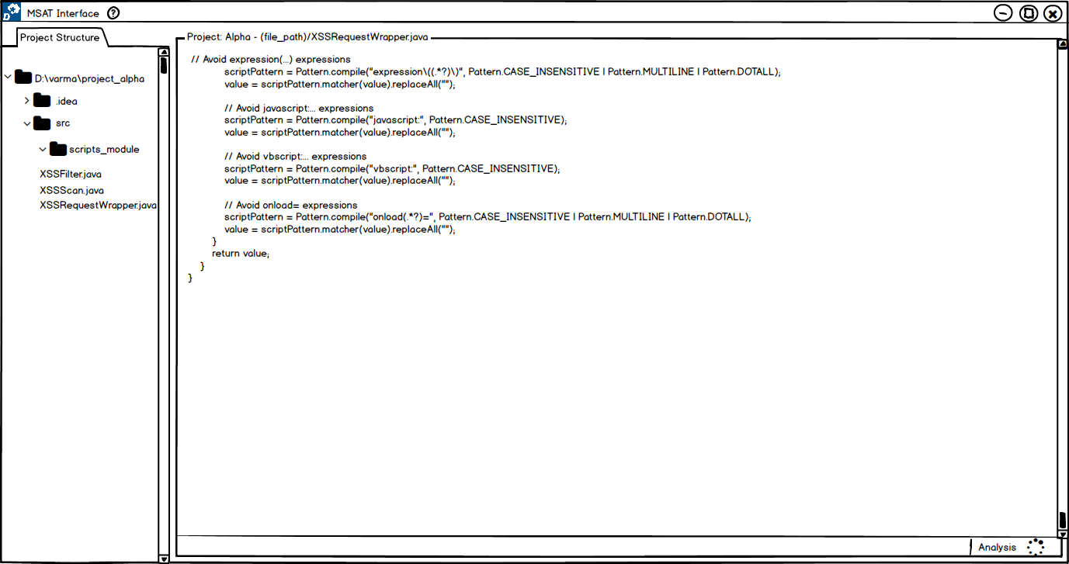
[RQ 2] From code view perspective, i.e., once user ﬁxed a bug and submitted for analysis and then oﬀ the analysis results screen, then is popup notiﬁcations with analysis progress information better to busy status (spinner)?
Popup notifications solution idea outwins status spinner with majority of 4 out of 7. Although remaining said it is annoying, but if needs implemented they would prefer to have when bug fix fails.

Slide 57
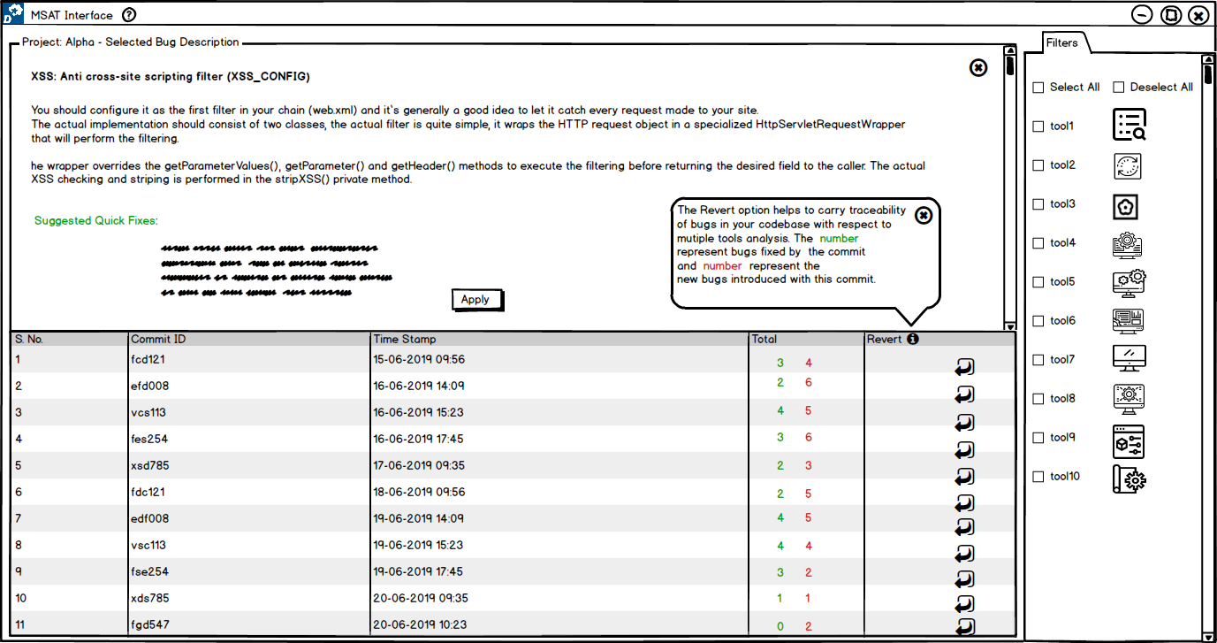
[RQ 3] In tracing, will the user need to know the changes made to ﬁx a bug aﬀecting the analysis of other tools?
Yes! With number representation, it is good, but those do not represent difficulty.

Slide 58
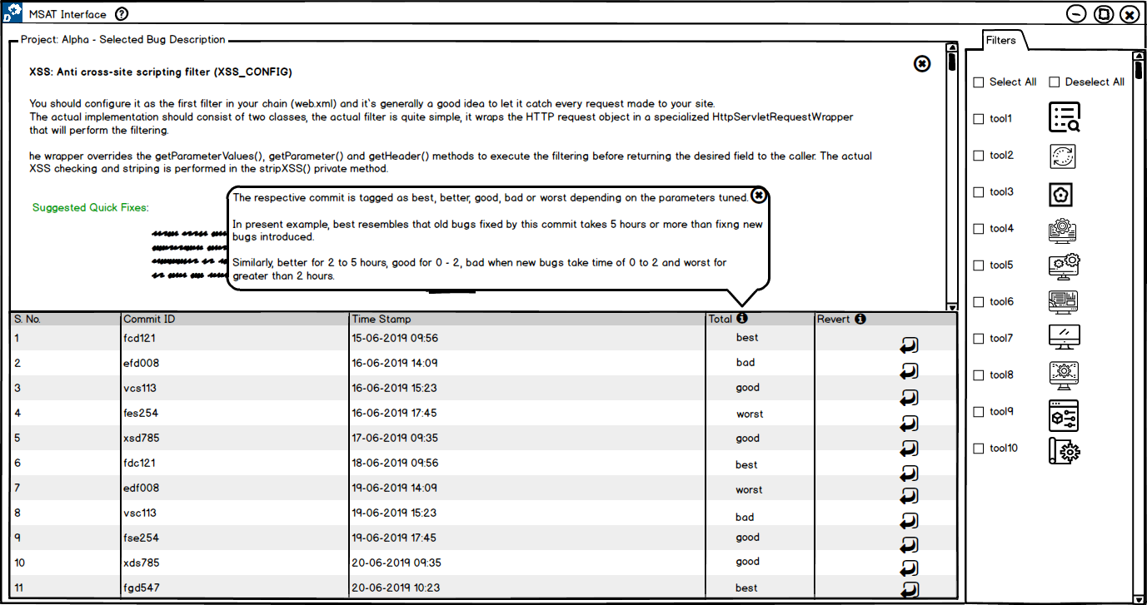
[RQ 3] Does adjective mapping ease the user to trace the changes made in code in terms of bugs existence?
Yes! With number representation, it is good, but those do not represent difficulty.

Slide 59
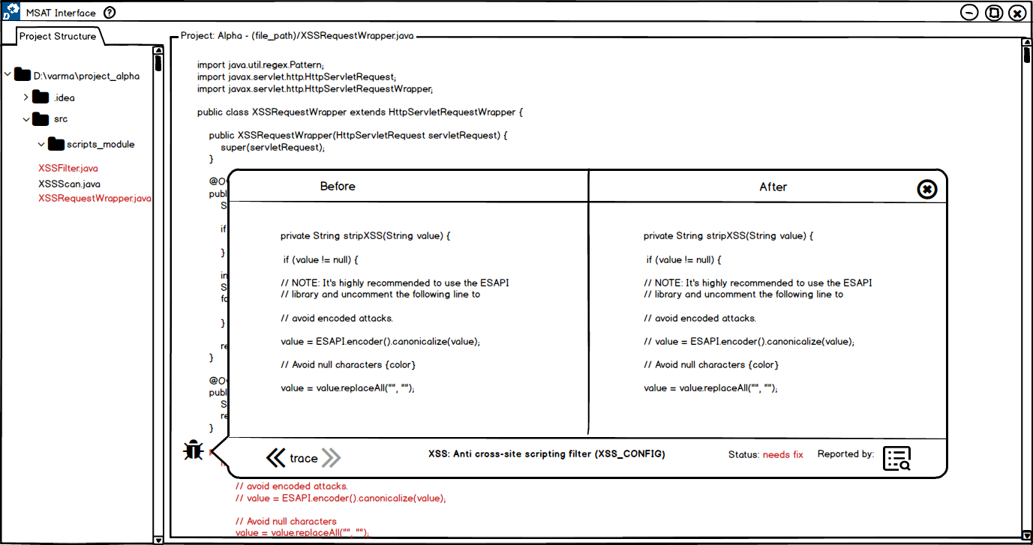
[RQ 3] From code view perspective, will the bug tool icons with before/after code help understand the user in easing to ﬁx it?
Yes! Users felt helpful in tracing, although they did not understand the design in
first glance as it is novel.

Slide 60
UX 3

Slide 61
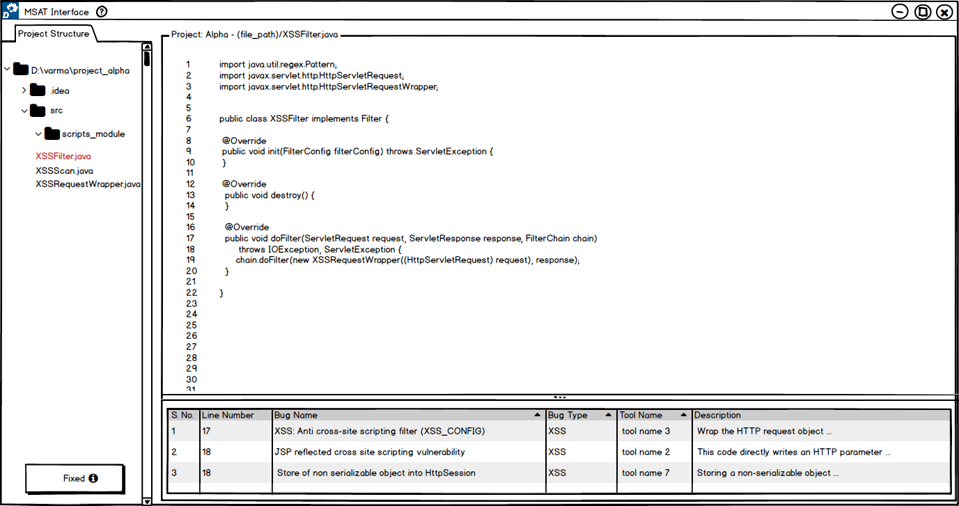
[RQ 1] Do users prefer bug icons or list view for bugs in same ﬁle?
Users preferred list view as it is more comfortable and friendly UI. In case of
huge codebase, bug icons solution idea would take more time in scrolling to identify bugs.

Slide 62
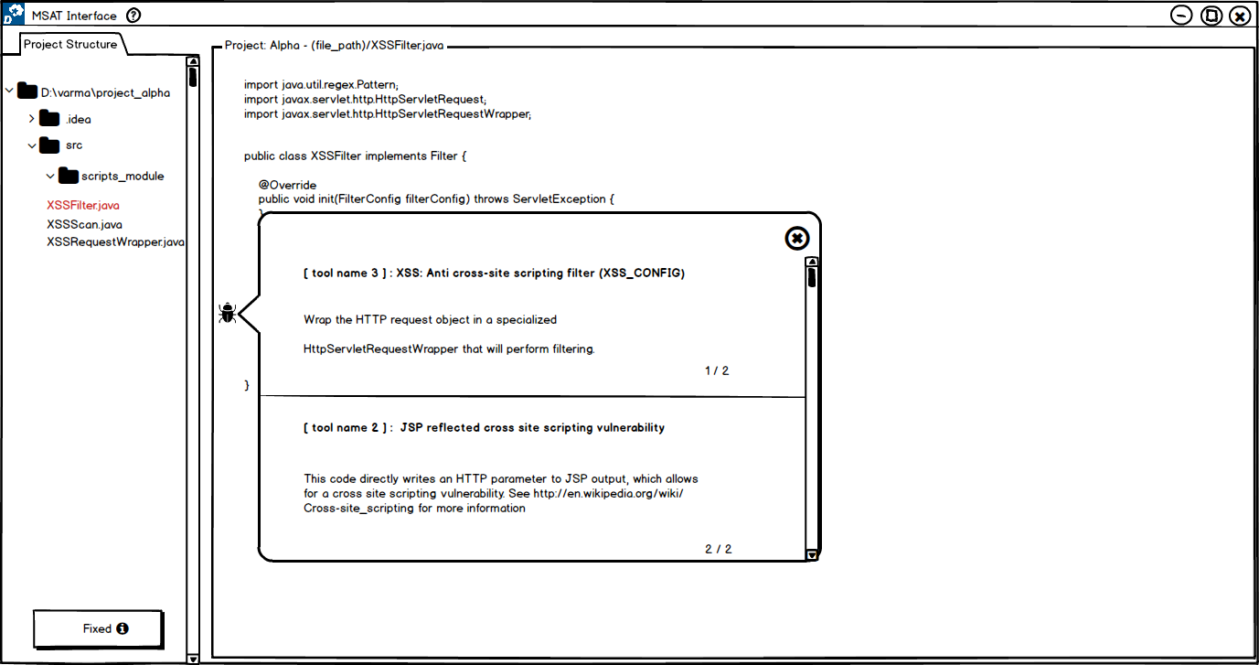
[RQ 1] Do users prefer to see bugs one by one or at once in the context of multiple bugs at the same time?
Users preferred horizontal view as it helps in comparing results when using multiple
tools. In general, users would like to go one by one and understand the results.
73

Slide 63
[RQ 1] Does vertical view help in getting an overview of the presence of multiple bugs over horizontal views?
The users mostly prefer horizontal view solution idea as they got used to such
proposed UI concerning scrolling. In case of vertical view solution idea, users felt it is
best suited for more landscape screens and touch screens.

Slide 64
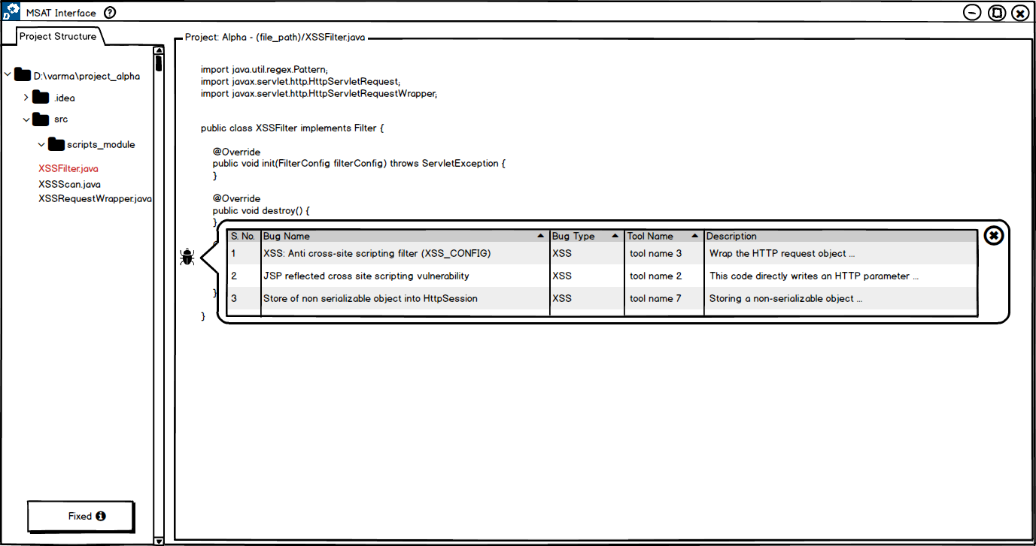
[RQ 1] Do users prefer for table view over text description shown for multiple bugs at a line of code?
Users preferred table view over text descriptions as it helps to sort the results
and so support comparison.

Slide 65
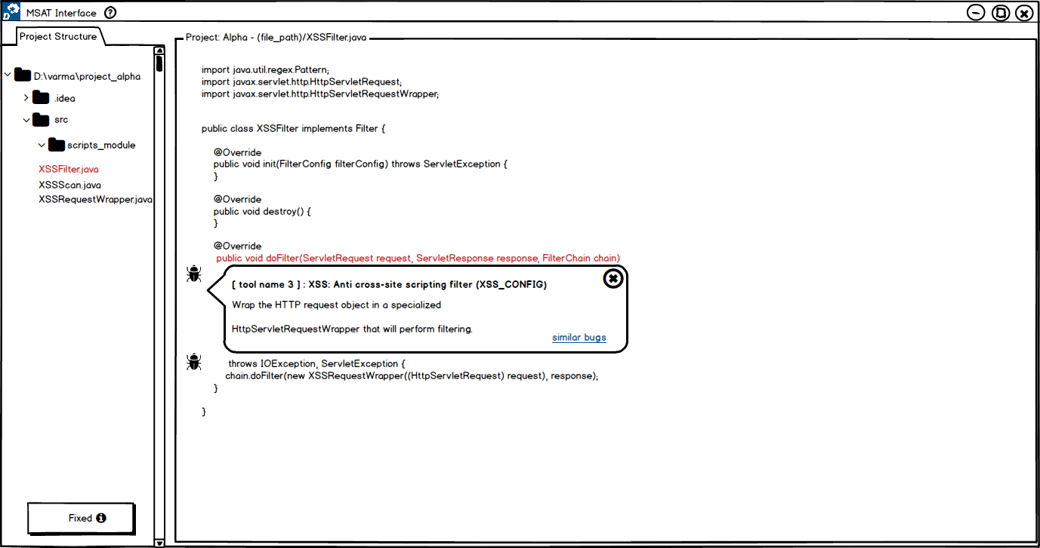
[RQ 1] In context of same bug identiﬁed but with diﬀerent line numbers, would have ‘similar bugs’ in bug description with on click pops up similar bug description boxes at the identiﬁed line or a list at the bottom help user in locating actual line where bug exist?
list
Users preferred list solution idea as with additional popups; it would be confusing
and time-consuming.

Slide 66
[RQ 2] Evaluation Set Up: 5 Feedbacks – MSAT-UI Vs Native UIs
Three different native UI tools for a single JavaScript project.
CLI – ESLint
IDE – SonarLint
WEB - SonarQube

Slide 67
[RQ 2] How usable are each feedback functionality compared to the scenario of using uniﬁed UI to native UIs?
Animated Icons
Progress Bar
Pending Status Popup
Alerts
Status
Almost all users agreed the ideas being novel and hardly present with native UIs.
Each proposed feedback play an essential role in providing the information to the
user. Some are absent in existing tools.

Slide 68
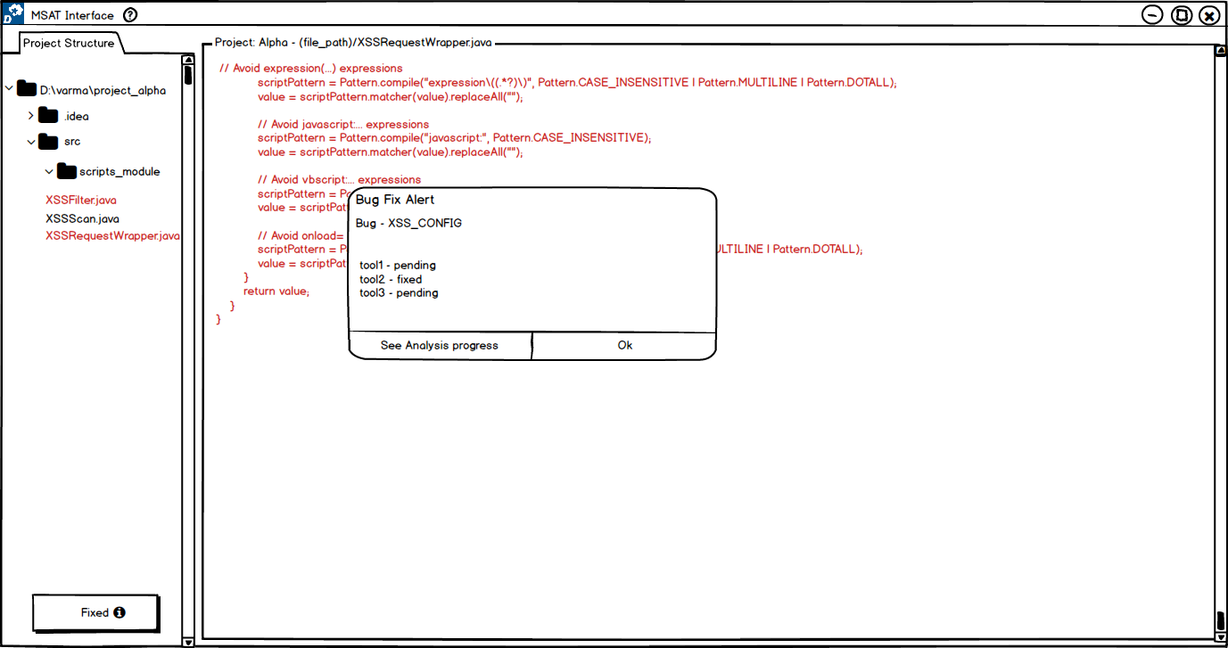
[RQ 2] Does alert notiﬁcation help in ﬁxing more bugs in contrast to its absence in current tools UI?
Users felt it as useful to have. As in case of success, it helps the developer have
positive fulfilment in fixing the bug and in case of failure, the developer could re-try the
bug fix again easily.

Slide 69
[RQ 2] Does MSAT UI with ﬁve diﬀerent mechanisms helps in ﬁxing more bugs in comparison to using multiple tools with native user interfaces?
Alert - when bug fix failed, helps to work on the bug again ( state of work flow )
Status – time for analysing
Yes! Users will be attentive with the provided feedbacks.

Slide 70
[RQ 2] Does MSAT UI with ﬁve diﬀerent mechanisms helps in ﬁxing the bugs in a faster way in comparison to using multiple tools with native user interfaces?
Visualisations provided by these 5 feedback helps!
Example: Progress Bar – helps in waiting than making system hang
Yes! with the help of direct visualisations provided by the proposed feedbacks.
Notably, ‘alert’ is helpful to try again to fix the bug immediately in case of bug fix fail.

Slide 71
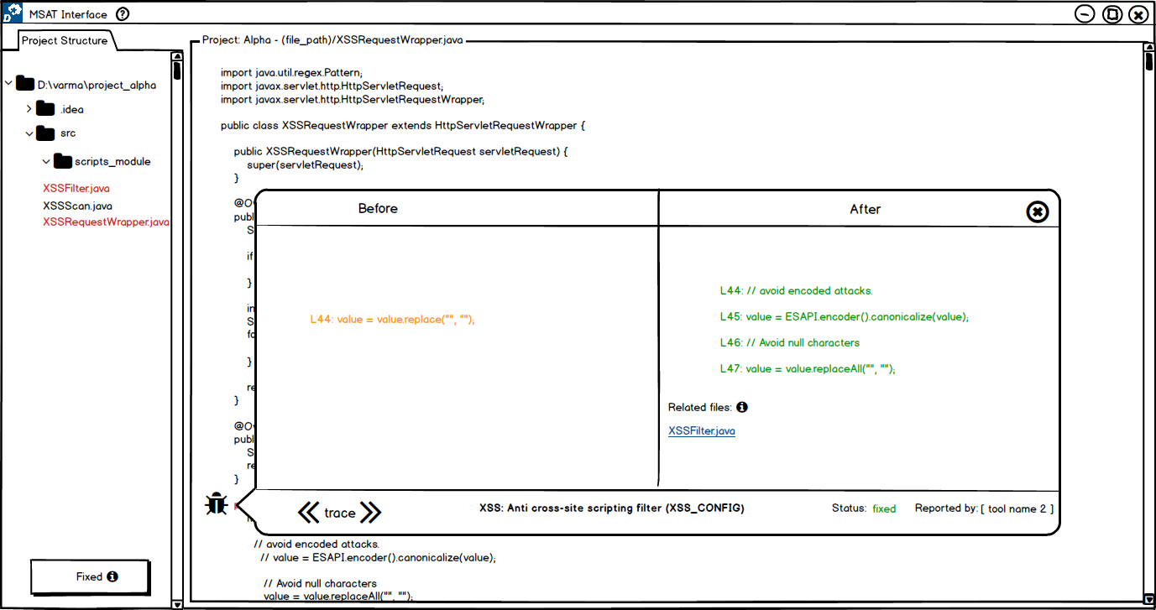
[RQ 3] Do users prefer having multiple windows to single window in tracing previous bug ﬁxes in a method?
Users preferred single window as it is easy to perceive results.

Slide 72
[RQ 3] Do users be able to keep up in state of workﬂow as tools scale?
Yes! proposed solution ideas promised to keep up the scalability.
However, users preferred ‘table view’ as easy with their consistency model.

Slide 73
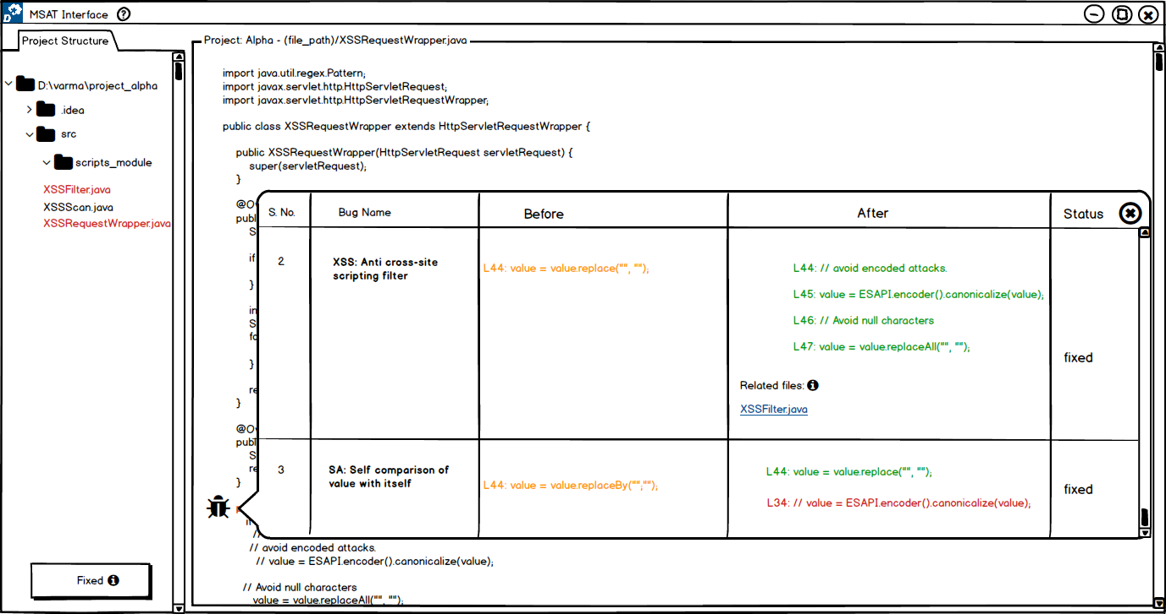
[RQ 3] While tracing previous bug ﬁxes in a method, do users prefer a table view to a before/after windows?
Users found both are useful, but in case of scalability, 4 out of 5 users preferred
table view.

Slide 74
Q. Do users prefer having tool names in general?
Yes!
Compare tool performance
Helps to have much information as possible

